Slide 1

22nd Annual General Meeting 2025
Pädagogische Hochschule Salzburg
Friday, 30 May, 15:30−17:00 CET

Slide 2
Proposed Agenda
Approval of the agenda and Approval of the minutes from the 2024 AGM
Reports on EALTA activities since the last AGM including: Activities and events
Election of Trustees
Revision of EALTA Guidelines for Good Practice: update from task force
Upcoming EALTA Conferences
Venue and date of the next AGM
AOB
Do you approve this agenda?
Yes
No
Abstain

Slide 3
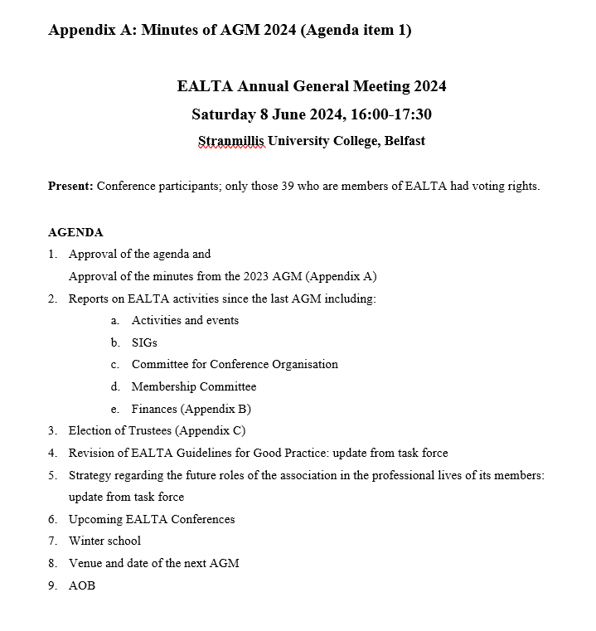
Approval of current agenda & minutes from AGM 2024
Do you approve the minutes of the 2024 AGM?
Yes
No
Abstain

Slide 4
2. Reports on EALTA activities since the last AGM
Slobodanka Dimova, President,
the EALTA Trustees, and
Members

Slide 5
Activities and events

Slide 6
Activities and events
Date | SIG / Event | Format | Title / Trainers
18-19/10/2024 | CEFR SIG | Conference | Responding to the CEFR Alignment Handbook: Sharing experience of alignment activities and reflecting on lessons learned
12/11/2024 | Signed Language Assessment | Webinar, on Youtube | SIG4SIGN Creating CEFR-aligned sign language tests
9-13/12/2024 | EALTA Winter School | In-person, Innsbruck | Tasks in language assessment Kathrin Eberharter, Judit Kormos, Marije Michel, Koen Van Gorp, Paula Winke
30/01/2025 | EDI SIG | Online meeting | Equality, Diversity and Inclusion Special Interest Group Online meeting
5/03/2025 | SIG Artificial Intelligence for Language Assessment | Online meeting, on website | EALTA Special Interest Group: Artificial Intelligence for Language Assessment Online meeting
18/03/2025 | Multilingual Language Assessment SIG | Online meeting | The nexus between multilingualism and assessment: Taking stock
25-27/04/2025 | Workshop on Profile analysis | In-person, Prague | Norman Verhelst and Ivailo Partchev

Slide 7
EALTA funded activities
EUR 3,500 for activities organized by EALTA members
The 2025 EALTA Summer School
The Sign Language SIG webinar
UALTA’s Jubilee Conference
Workshop on Profile Analysis
To achieve wider outreach, the following selection criteria were applied:
Supporting EALTA's mission
Cost-effective & sustainable budget
  Additional funding (other sources)
    Other organizations/institutions
    Registration
    Presenters
Looking forward to your applications for the next call

Slide 8
EALTA communication strategy
Two new activities to strengthen communication with EALTA membership
LinkedIn account
EALTA newsletter (bi-annual)
  News about EALTA activities
  Information about upcoming conferences
  Featuring an institutional member
  Featuring a PhD student
  Other sections?
Upcoming calls for contributions to the newsletter

Slide 9
Special Interest Groups (SIGs)

Slide 10
SIG reports summary
Collaboration: across SIGs (joint SIG meetings), with organisations (Barcelona alignment conference) and individuals
Innovation: in terms of topics (AI-related, EDI-related in various SIGs), important research contributions across the board
Inclusion: on various levels pertaining to accessibility of events, expertise and professional development
Variety of formats
help promote EALTA‘s mission
Thank you to the SIG convenors!
Notes:
For the first time, SIGs were asked to provide the exec with a yearly report of activities from one AGM to the next. The purpose of this report is for the SIG convenors to showcase their activities and for the exec to develop a better awareness of them, also as a means to strengthen communication between Executive Committee & SIGs.
. I have synthesised the activities of the 8 SIGs.
The SIGs demonstrated a large variety of topics they worked on. One important feature last year was collaboration, across SIGs (e.g. joint SIG Writing/Languages for specific purposes with their tradition of joint SIG meetings, but also joint meetings of MLA/CBLA). Collaboration with organisations (The CEFR SIG and the very successful Barcelona alignment conference 2024), and with individuals (e.g. CEFR SIG, AI SIG, MLA SIG). At this conference, we have seen a fair amount of joint SIG meetings and there is potential for more if the SIG convenors so wish.
Innovations is another aspect that was obvious in the reports. Topics of SIGs are timely and have innovative edges, e.g. AI-related or EDI-related topics across SIGs, with important research contributions being made that range from alternative assessment frameworks, item generation with AI, CEFR-aligned sign language tests to DIF in placement and certification tests for migrants, among many others.
Inclusion: is an objective that is close to EALTA‘s mission, and it is reflected in the SIG activities. Inclusive activities concern e.g. members who are not able to attend in-person events by launching online events (AI, SIG4SIGN, MLA), SIG4SIGN online events are interpreted from/to International Sign /English and thus are accessible to deaf researchers and practitioners
All these activities help promote EALTA‘s mission. This happens in a variety of formats, namely webinars, online meetings, lightning talks, brown-bag sessions, exchange of best practice
Thank you to the SIG convenors for making this possible!
Here are the major key points:
1. Collaboration took place across SIGs (Writing/Languages for Academic Purposes /AI, MLA/CBLA)

Slide 11
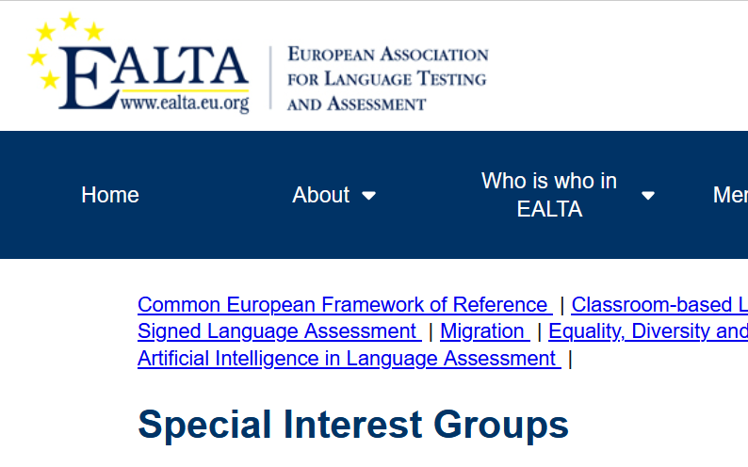
SIG space on the website
Goal: to concentrate SIG information and activities within EALTA website
  SIGs provided with login details and instructions
  Can create, manage and update their own content
  BUT
  Not used as expected
    Some SIGs – subtabs?

Slide 12
Website and mailing list

Slide 13
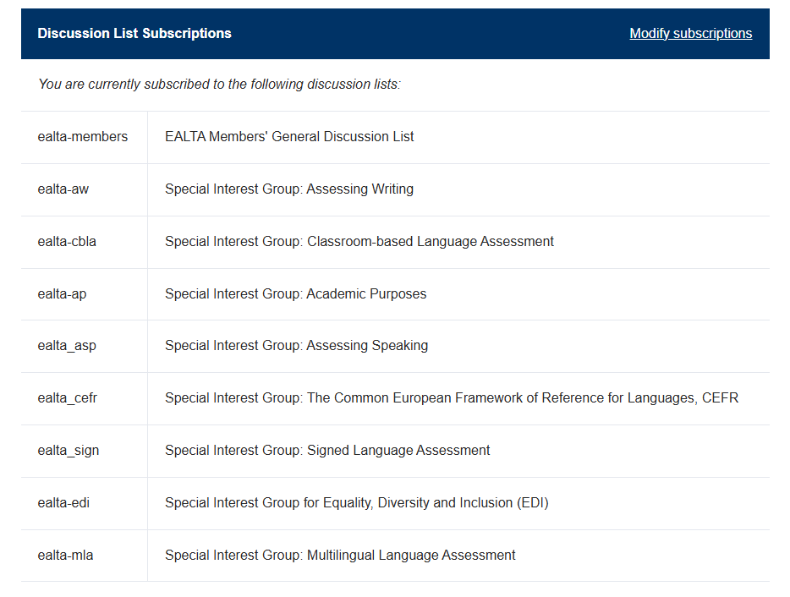
Website and mailing list
Website
  Updated
  Not much new information – send us your tips!
Membership subscription
  check and correct/update your data – many undelivered e-mails
  1 person – different e-mails – sending mails, asking, manual deleting...
  Plan: regular renewal message
Issues with mailing list
  Attempt to get a commercial solution
  Small tender, Amazon (AWS) selected – several attempts to justify our intention - EALTA got rejected
  SendGrid selected – tested in May
  Next step: discussion list

Slide 14
Committee for Conference Organization
Sonja Zimmermann (Chair)

Slide 15
Committee for Conference Organization
Team for 2025
Sonja Zimmermann
Thomas Koidl (local organiser)
Debbie Candy (finances, sponsoring)

Slide 16
Committee for Conference Organization
21st EALTA Conference in Salzburg
170 participants from 30 countries
(33 participants from 11 countries outside Europe)
very high number of proposals, strict selection
(3 reviewers/proposal)
54 presentations in total, incl. keynotes, WiPs and posters
+ one symposium
1 invited panel
2 PCWs
5 SIG meetings with a total of 91 participants

Slide 17
Committee for Conference Organization
Other Business
Conference website
New format for WiP presentations
  revision of vetting criteria
  video tutorial for presenters (in the making)
Streamlining submission and vetting process (upcoming)

Slide 18
Membership Committee
Karin Vogt (Chair)

Slide 19
Membership Committee Members
Tineke Brunfaut
Nivja de Jong
Eleni Meletiadou

Slide 20
EALTA Membership numbers 20 May 2025
Individual members: 1600 / 44 countries +23
Associate members: 309 / 64 countries -7
Institutional members: 54 / 25 countries +1
Expert members: 20 / 11 countries +0
Affiliate sister organizations: 2
Notes:
Associate members: slight decline, due to fluctuation and data cleaning (double entries deleted)

Slide 21
Finances
Voula Kanistra (Treasurer)

Slide 22
General updates
✅ Completed process for Gift Aid & Tax Repayment Claims
  HMRC recognises EALTA as a Charitable Incorporated Organisation (CIO)
    that the EALTA, as a CIO, meets certain standards
    demonstrates transparent financial practices
    enhances credibility with donors
  Boosts donation value by 25%
    If a UK taxpayer donates to EALTA, then EALTA can claim an extra 25% on top of that donation.

Slide 23
General updates continued
Reconciliation of expenses
  Microsoft 365 business subscription
    Cloud storage
    Access to Microsoft tools
      Cancelled Survey Monkey
Switching financial reports to calendar year
  Financial reporting to Companies House in UK
    Avoid paying external auditor twice
    Transparency & consistency (same amounts in AGM & official financial submissions)
EURO account activated

Slide 24
Next Steps
Transition to another bank based on the following:
  Allow EALTA to use euro account for payments easily
  EALTA to have a card to pay subscriptions (e.g. Microsoft, mailing list, YouTube)
  Retain existing good features
Issue official financial procedures
  Uploaded on our CIO account

Slide 25
General overview

Slide 26
Exploring income

Slide 27
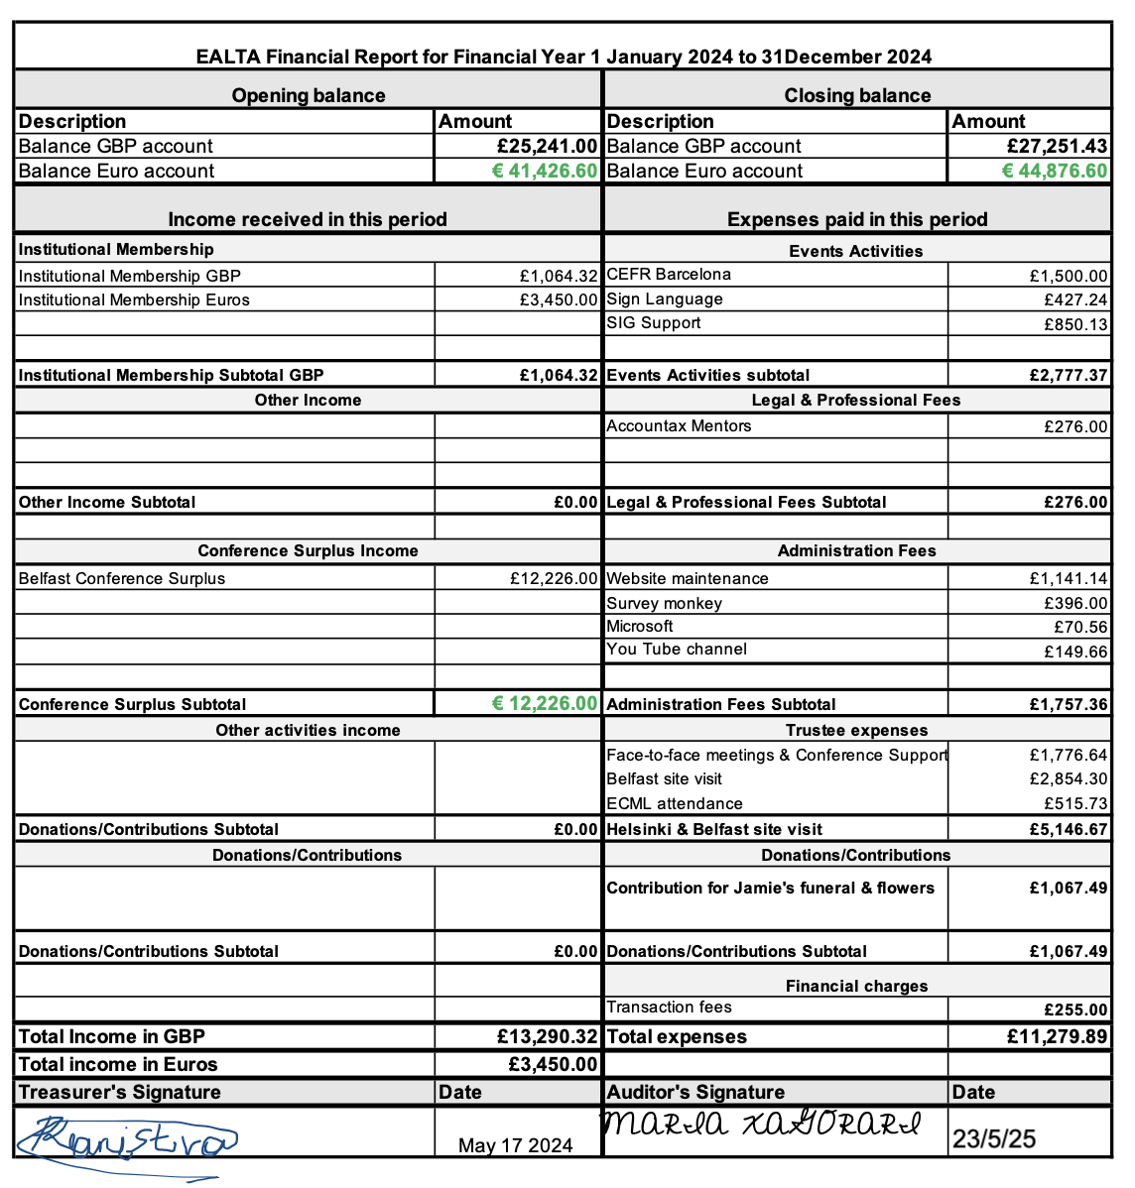
Finances
Do you accept the 2023-2024 financial report?
Yes
No
Abstain

Slide 28

Important to remember

Slide 29
3. Election of Trustees

Slide 30
Nominations
Trustee position | Nominated | Yes | No | Abstain
Secretary | Cristina Rodriguez
Treasurer | Voula Kanistra

Slide 31
Election of Secretary
One nomination: Cristina Rodríguez,
Nominated by Neus Figueras and Joyce Kling
Yes
No
---

Slide 32
Election of Member
One nomination: Voula Kanistra,
Nominated by Aylin Unaldi and Anika Müller-Karabil
Yes
No
---

Slide 33
4. Revision of EALTA Guidelines for Good Practice
Update from task force
Ari Huhta

Slide 34
Reasons for the review and revision
Original Guidelines for Good Practice were designed about 20 years ago (2006)
  → Some / many changes have taken place in language testing and assessment
Rise in importance of considerations regarding equity, diversity and inclusion (see also ILTA Task Force on JEDI)
Emergence of artificial intelligence and digital tests/assessments in general

Slide 35
EALTA Guidelines of Good Practice
Task Force 2024-2025
Set up by Jamie Dunlea in late 2023 / early 2024 on behalf of the EALTA Executive Committee
Members:
  Cecilie Carlsen
  Kathrin Eberharter
  Ari Huhta
  Benjamin Kremmel
  John Pill
  Richard Spiby
Task: to review and propose revisions to (English version of) the guidelines

Slide 36
What remains (more or less) unchanged
Question format
  Most of the guidelines / questions remain unchanged
  Some small rewordings: Is X done …? → To what extent is X done …?
Same three key stakeholder groups / types of activities
  No new groups added
Guidelines / questions remain rather general / broad in nature
  Specific, concrete examples only if necessary to clarity the guideline
  … because these are general principles, not detailed guidelines for test design, scoring, analysis, validation, etc

Slide 37
Main proposed changes to EALTA GGP
The three main stakeholder groups / activities re-ordered and partly renamed:
  A. Certification recognised at international, national or local level
  B. Pre-service or in-service training in assessment of language teachers
  C. Classroom-based testing and assessment
New section under A
  Test use and consequences
New subcategories and new content for B
  Components foregrounding theoretical concepts
  Components foregrounding practical work
  Components foregrounding ethical considerations
References to the use of AI and digitalisation in testing and assessment added

Slide 38
Next steps in the process
Circulate EALTA member survey & elicit comments on EALTA GGP
Finalize the EALTA GGP based on member comments
Meet to present the final version of the EALTA GGP
Publish the GGP

Slide 39
5. Upcoming EALTA conferences

Slide 40
Upcoming EALTA conferences
Conferences venues confirmed until 2027
  Siena, Italy, 9-14 June 2026
  Bedfordshire, UK, 7-12 June 2027
Call for conferences in 2028 and 2029 will go out later this year

Slide 41
6. Venue and date of the next AGM

Slide 42
EALTA 2026
Siena, Italy
June 9 – 14th, 2026

Slide 43


22nd EALTA Conference
Literacies Across Different Stakeholder Groups
University for Foreigners of Siena, Italy
Join us!
9 - 14 June 2026

Slide 44
7. AOB

Slide 45
Proposal about a logo specially designed for institutional members

