Slide 1
21st
Annual General Meeting 2024
Stranmillis University College, Saturday, 8 June, 16.00-17.30

Slide 2
Proposed Agenda
Approval of the agenda and Approval of the minutes from the 2023 AGM
Reports on EALTA activities since the last AGM including: Activities and events
Election of Trustees
Revision of EALTA Guidelines for Good Practice: update from task force
Strategy regarding the future roles of the association in the professional lives of its members: update from task force
Upcoming EALTA Conferences
Winter school
Venue and date of the next AGM
AOB
Do you approve this agenda?
Yes
No
Abstain

Slide 3
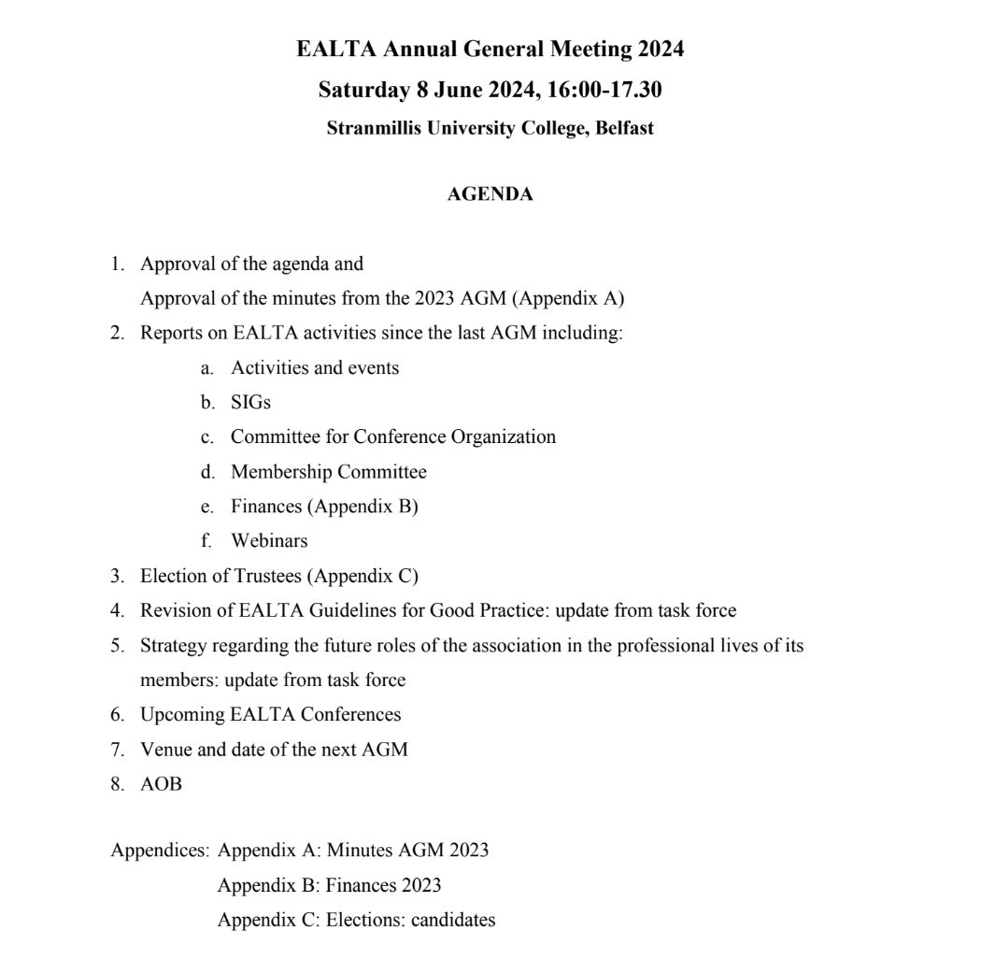
Approval of current agenda & minutes from AGM 2023
Do you approve the minutes of the 2023 AGM?
Yes
No
Abstain

Slide 4
2. Reports on EALTA activities since the last AGM
Slobodanka Dimova, President,
the EALTA Trustees, and
Members

Slide 5
Activities and events
Date | SIG | Format | Title & speakers
18/10/2023 | Migration | Webinar, on Youtube | Language Policy Index for Migration (LAPIM) Cecilie Hamnes Carlsen & Lorenzo Rocca
22/11/2023 | Signed Language Assessment | Webinar, on Youtube | Developing Rating Scales for Sign Language Assessments Ute Knoch, Katja Tissi, Franz Holzknecht, Tobias Haug, Alessia Battisti, University of Zurich, & Nivja de Jong
17/01/2024 | Equality, Diversity and Inclusion (EDI) | Online meeting | Lynda Taylor, Petra Smelak, Sylwia Macinska, Carla Pastorino-Campos, & GladysQuevedo-Camargo
10/02/2024 | Multilingual language assessment | Online meeting | Georgios Neokleos, Sviatlana Karpava, Viktoriia Osidak Taras Shevchenko & Maryana Natsiuk
1-2/03/2024 | Assessing Writing & Academic purposes | In-person, Bremen | The Use of Generative AI – Promises and Perils for Assessing Writing and Assessing for Academic Purposes Erik Voss

Slide 6
Special Interest Groups (SIGs)
First SIG summit held on April 8, 2024
Participants: Executive committe members & convenors of 7 SIGs
Purpose: Strategic apporaches to planning activties across SIGs—including meetings & outreach (given the growing number of SIGs)
Agenda:
SIG members’ preferences for meeting times & formats
Opportunities for and models of collaboration with other SIGs
Concerns regarding the current status and activities of SIGs
Visions for SIGs’ future

Slide 7
Summary of future considerations
SIG members’ preferences for meeting times
  Joint face-to-face (f2f) meetings
  Online or f2f meetings between conferences
  Webinars for wider outreach
  F2f meetings to maintain sense of community
SIG members’ preferences for meeting formats
A traditional format with presentations –possibility for SIG attendees to obtain funding for conference attendance
  Discussions, joint research projects, and opportunities for collaboration
    but combined with a more traditional presentation format

Slide 8
Points of action
Creation of a document which gives structure to the following:
  Strengthen communication within a SIG & between Executive Committee & SIGs
  Develop procedures for EALTA SIG collaborations/meetings/webinars/schools
  Concretize ways for SIGs to contribute to EALTA initiatives - for example, how can they contribute to guidelines, task forces, etc.
  Include a section on the new website with information about SIG activities

Slide 9
Committee for Conference Organization
Sonja Zimmermann (Chair)

Slide 10
Committee for Conference Organization
20th EALTA Conference in Belfast
165 participants from 26 countries, including 7 local one-day tickets
(25 participants from 9 countries outside Europe)
very high number of proposals, strict selection
(3 reviewers/proposal)
58 presentations in total, incl. keynotes, WiPs and posters
+ two symposia
2 PCWs

Slide 11
Committee for Conference Organization
Other Business
Vademecum for Conference Organizers updated (final revision process after Belfast conference)
Revision of vetting criteria ongoing
Monitoring of proposals for future EALTA conferences

Slide 12
Membership Committee
Slobodanka Dimova (Chair)

Slide 13
Membership Committee Members
Tineke Brunfaut
Nivja de Jong
Ari Huhta

Slide 14
EALTA Membership numbers 4 June 2024
Individual members: 1577 / 43 countries +128
Associate members: 316 / 60 countries +47
Institutional members: 69 / 23 countries +1
Expert members: 20 / 11 countries +1
Past expert members: 7
Affiliate sister organizations: 2 / +1

Slide 15
2. Finances
Voula Kanistra (Treasurer)

Slide 16
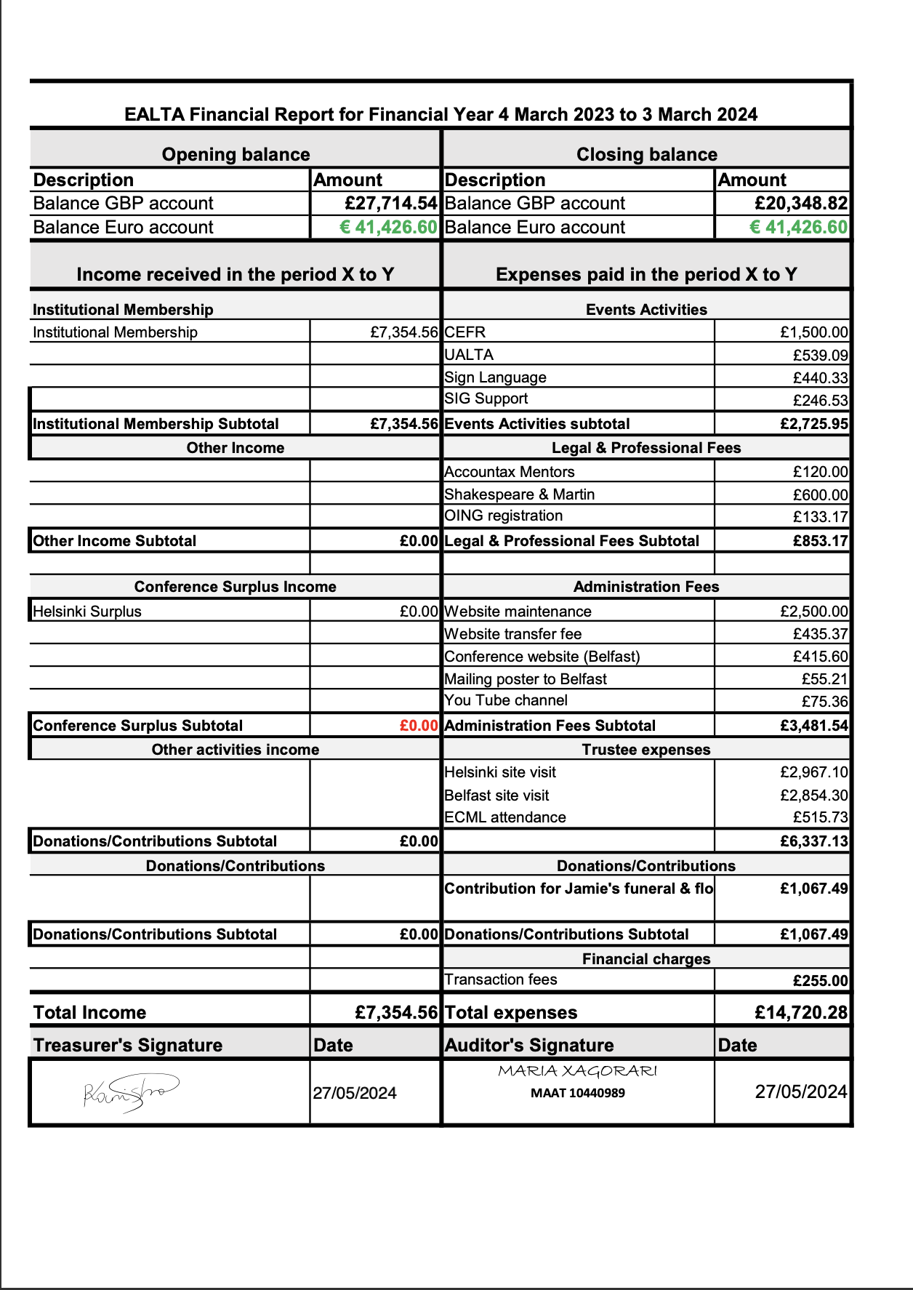
Finances
Activation of euro account
Alternative ways to bring in income
Clear guidelines for conference - related expenses
Detailed conference budget template
We may need to implement a sustainability plan
Do you accept the 2023-2024 financial report?
Yes
No
Abstain

Slide 17







Slide 18







Slide 19
3. Election of Trustees

Slide 20
Nominations
Trustee position | Nominated | Yes | No | Abstain
Chair of the Membership Committee | Karin Vogt
Member | Martina Hulešova

Slide 21
Election of Chair of the Membership Committee
One nomination: Karin Vogt,
Nominated by Norman Verhelst and Eli Moe
Yes
No
---

Slide 22
Election of Member
One nomination: Martina Hulešova,
Nominated by Peter Lenz and Tony Clark
Yes
No
---

Slide 23
4. Revision of EALTA Guidelines for Good Practice
Update from task force
Ari Huhta

Slide 24
5. Strategy regarding the future roles of the association in the professional lives of its members
Update from task force
Peter Lenz

Slide 25
Future Roles Task Force
Task Force Members
Tineke Brunfaut
Tony Clark
Peter Lenz (co-ordinator)
Doris Moser-Frötscher
Karin Vogt
Thanks to the Exec for their contributions!

Slide 26
Membership Survey
Areas covered
A Member‘s background
B Opinion on EALTA‘s mission
C Opinion on EALTA‘s existing activities
  C1 EALTA Annual Conference (including a potential online conference)
  C2 Other EALTA events
  C3 EALTA online media channels
  C4 EALTA offers for students and teachers
D Other thoughts and suggestions
Response to the questionnaire: 142 members, ~ 80 % made it until the end

Slide 27
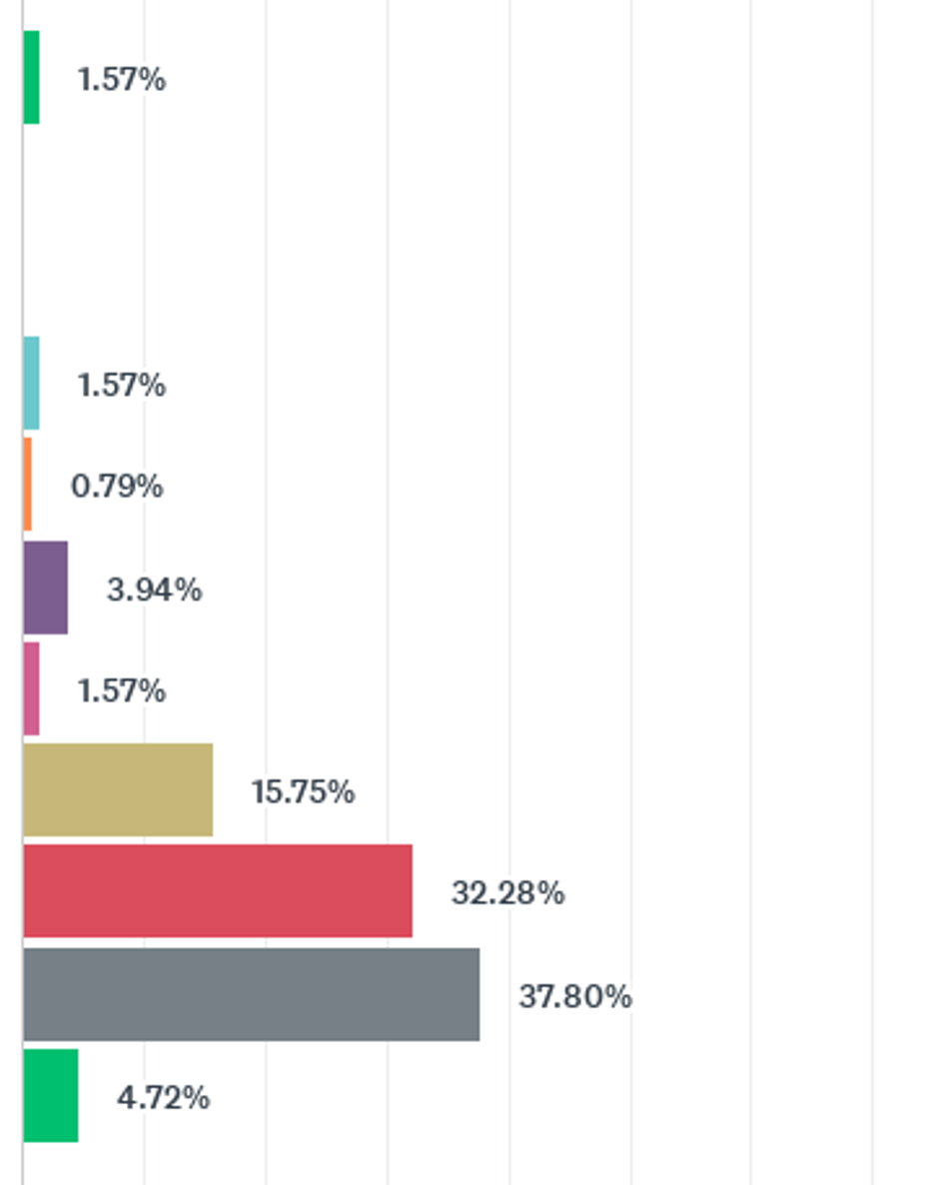
Mission statement
Q12 To what extent does EALTA’s mission statement align with your expectations of the association?
Not at all
EALTA’s mission
promote understanding of theoretical principles of LT&A
promote improvement and sharing of T&A practices throughout Europe
Entirely
Don’t know

Slide 28
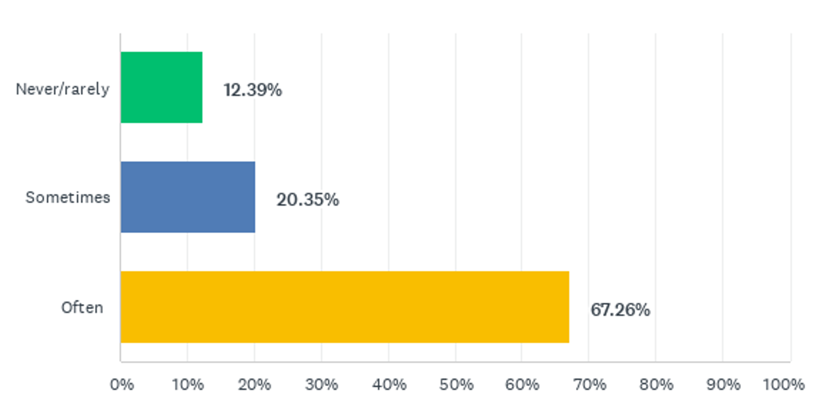
EALTA Information Channels
Q39 How often do you read discussion list messages?

Slide 29
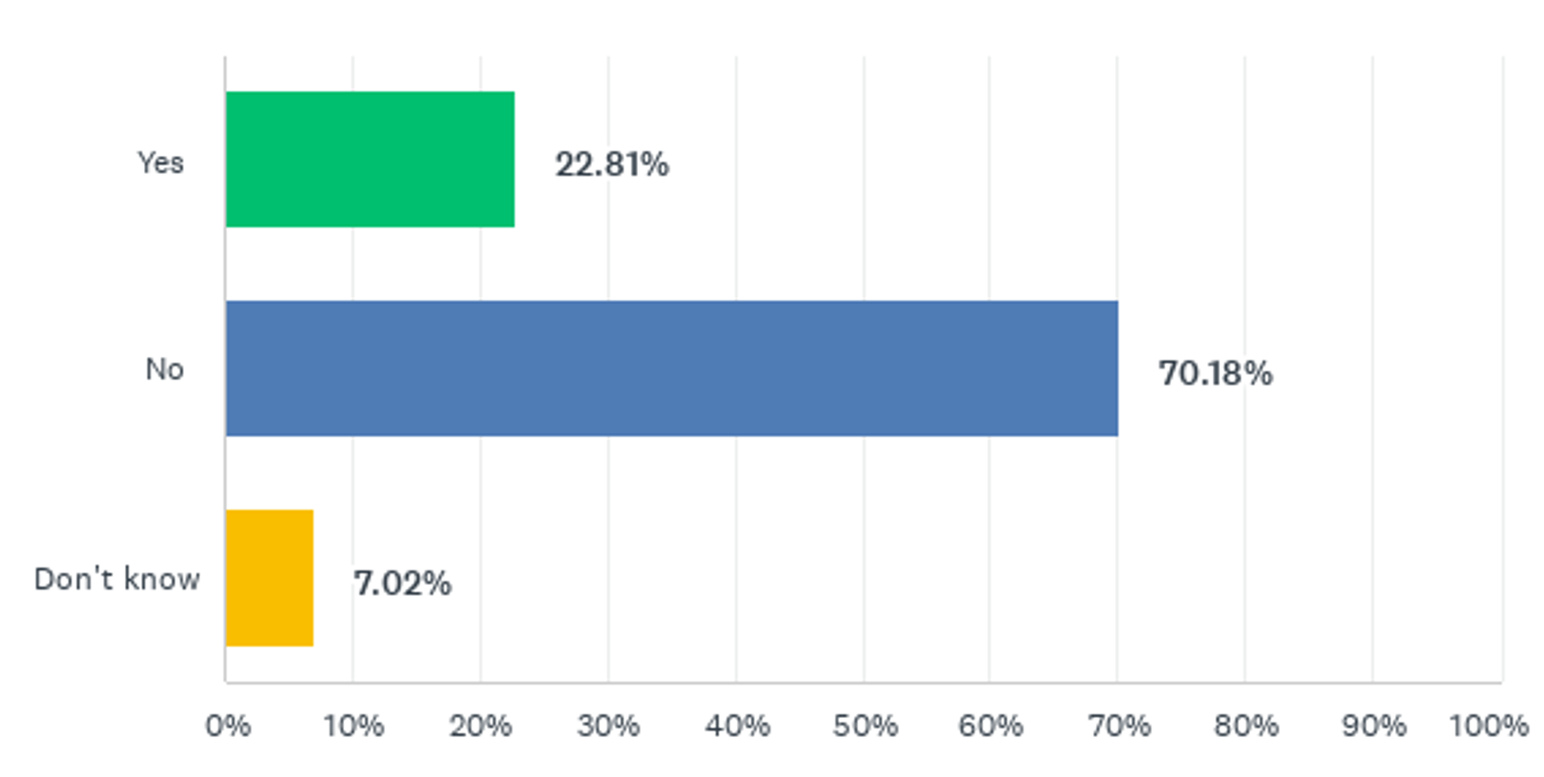
EALTA Information Channels
Q44 Have you ever visited the EALTA Youtube channel?

Slide 30
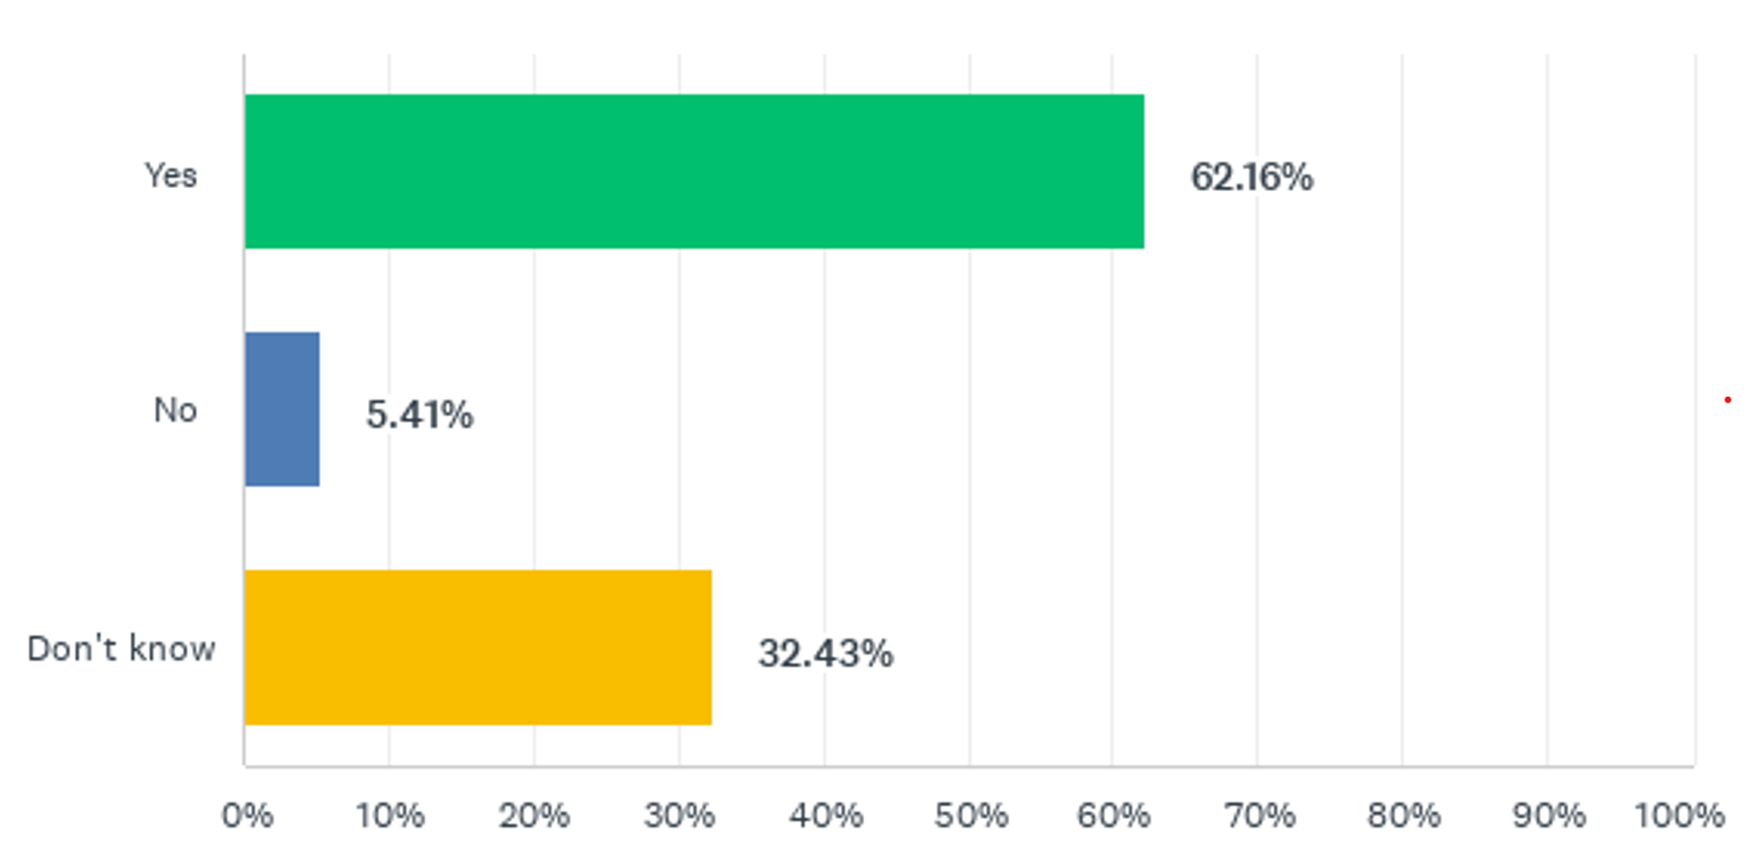
Expanding Social Media Presence
Q46 Is expanded social media presence desirable?

Slide 31
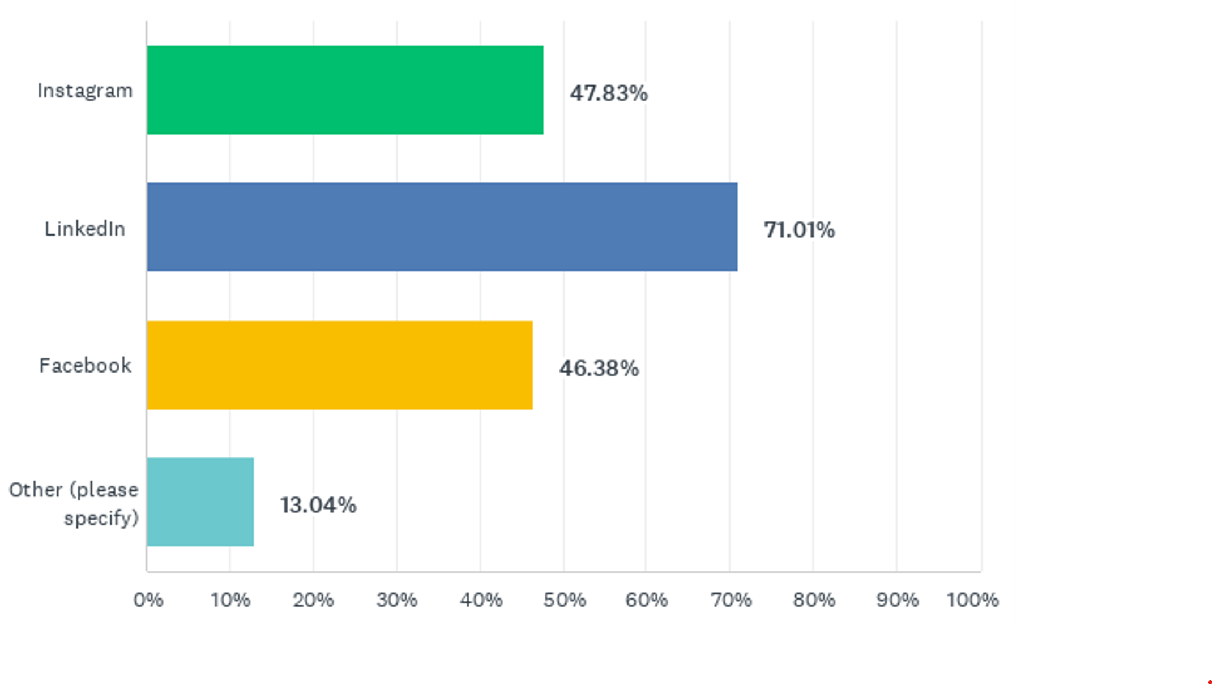
Expanding Social Media Presence
Q47 What additional channel(s) would you prefer for EALTA?

Slide 32
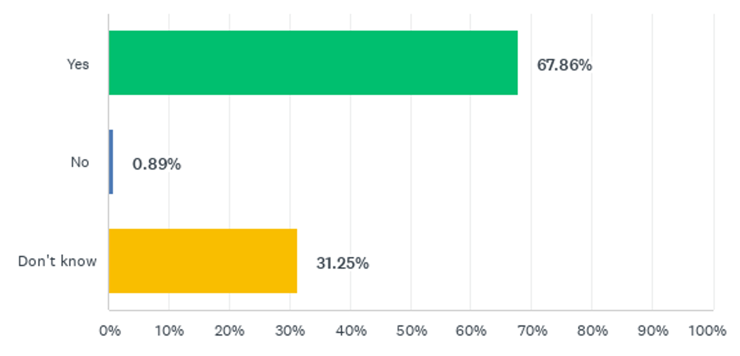
Activities for Students
Q50 Should EALTA offer specific activities for student members?

Slide 33
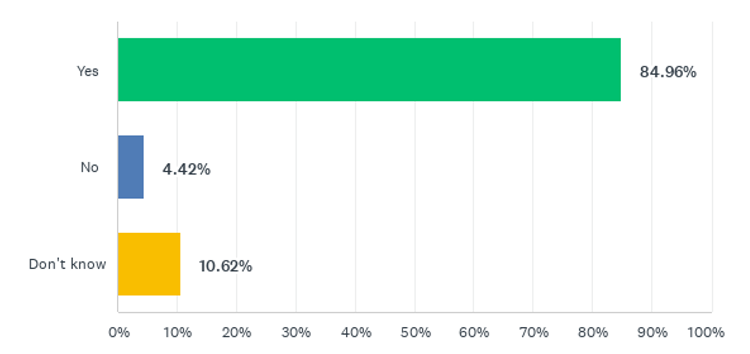
Activities for Teachers
Q52 Should EALTA offer specific activities for teachers?

Slide 34
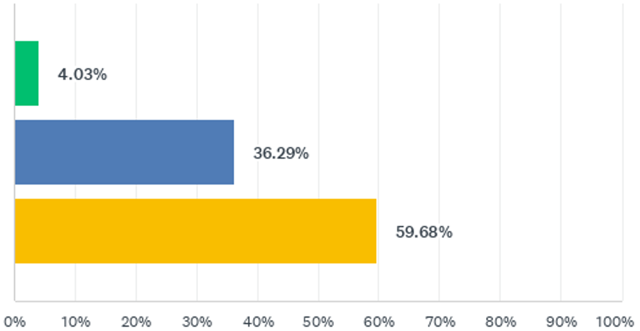
EALTA Annual Conference
Q16 How important is it for you that EALTA holds its Annual Conference?
Not very important
Somewhat important
Very important

Slide 35
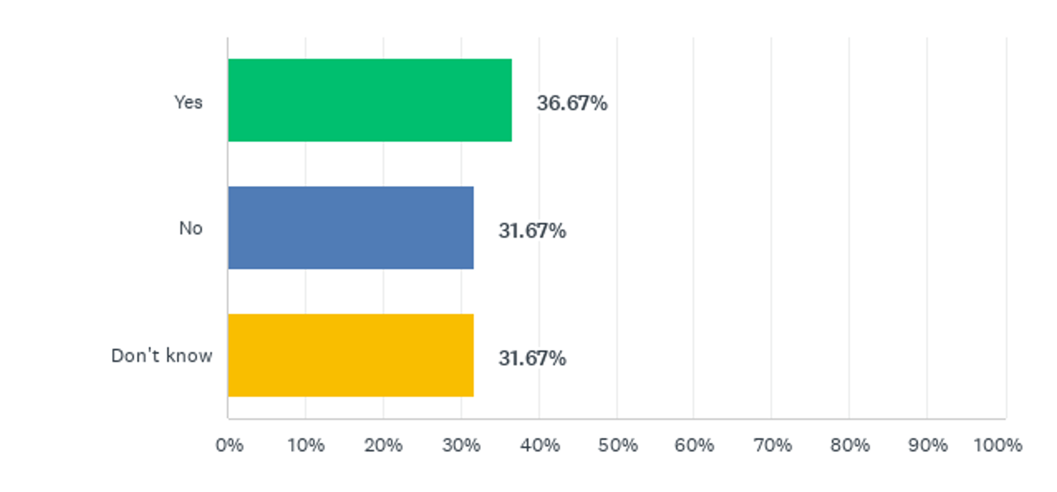
EALTA Annual Conference
Q21 Would you like to maintain the sessions on Sunday morning?

Slide 36
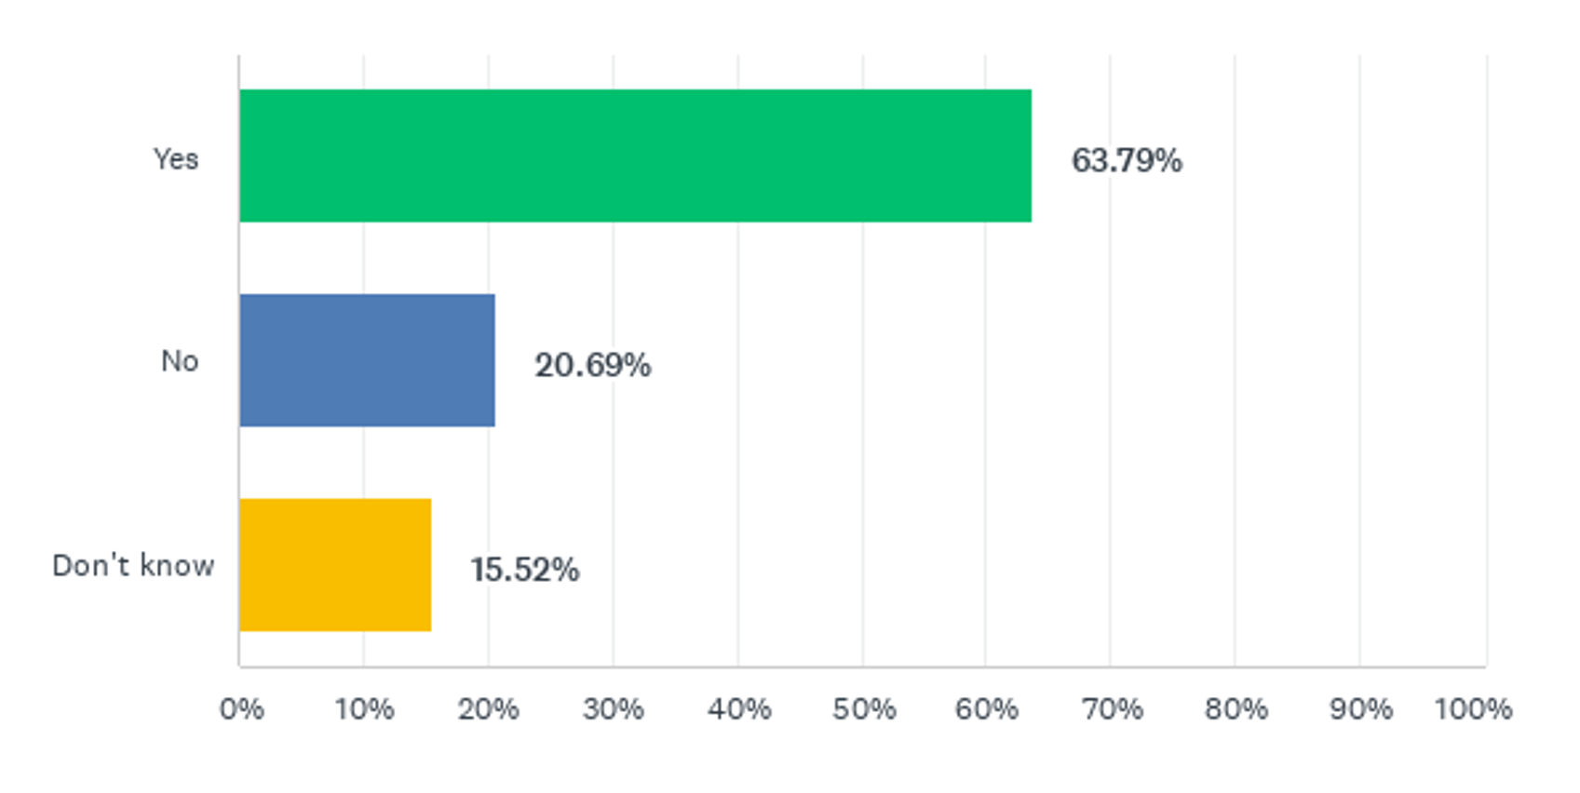
Triannual Online EALTA Conference
Q22 Would you agree to an online conference instead of a face-to-face conference every third year?

Slide 37
Next steps
Thorough analysis and report on survey
Selection of priorities
Implementation of selected offers/activities
Support from members needed …

Slide 38
6. Upcoming EALTA conferences

Slide 39
Upcoming EALTA conferences
Conferences venues confirmed until 2027
Possibility to bring in an external organiser
Based on the results of the survey, length and format of the conference need to be discussed at the next AGM
Open for discussion:
For the upcoming conference we consider allowing variable length of PCWs
Format of Work-in-Progress presentations
Registration fee

Slide 40
7. Venue and date of the next AGM

Slide 41

EALTA 2025
Salzburg, Austria
May 26 – 31st, 2025
Institut für Professionsentwicklung & Schulqualität (IPS)

Slide 42
Hosting Institution
Pädagogische Hochschule Salzburg Stephan Zweig
Teacher training college
University college since 2008
Elementary, primary and secondary teacher education and research
Pre-service and in-service teachers
School improvement
Institut für Professionsentwicklung & Schulqualität (IPS)

Slide 43
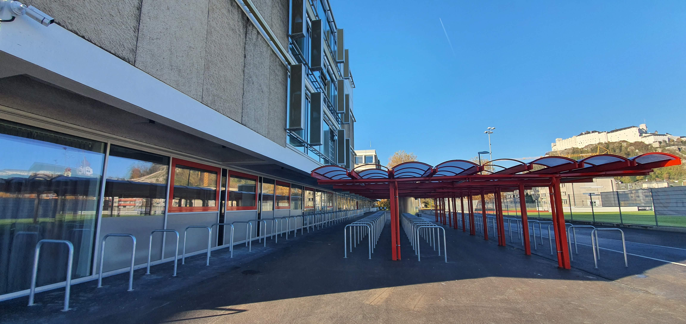
Venue
Institut für Professionsentwicklung & Schulqualität (IPS)

Slide 44
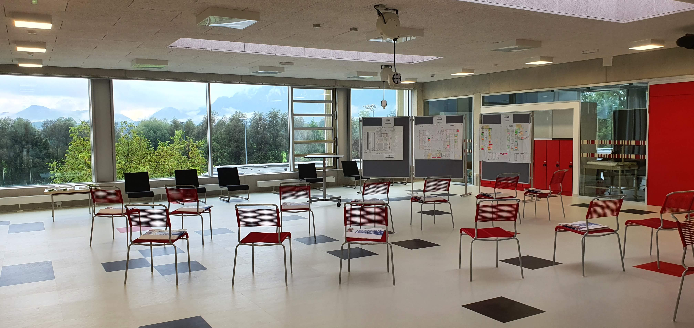
Venue
Institut für Professionsentwicklung & Schulqualität (IPS)

Slide 45
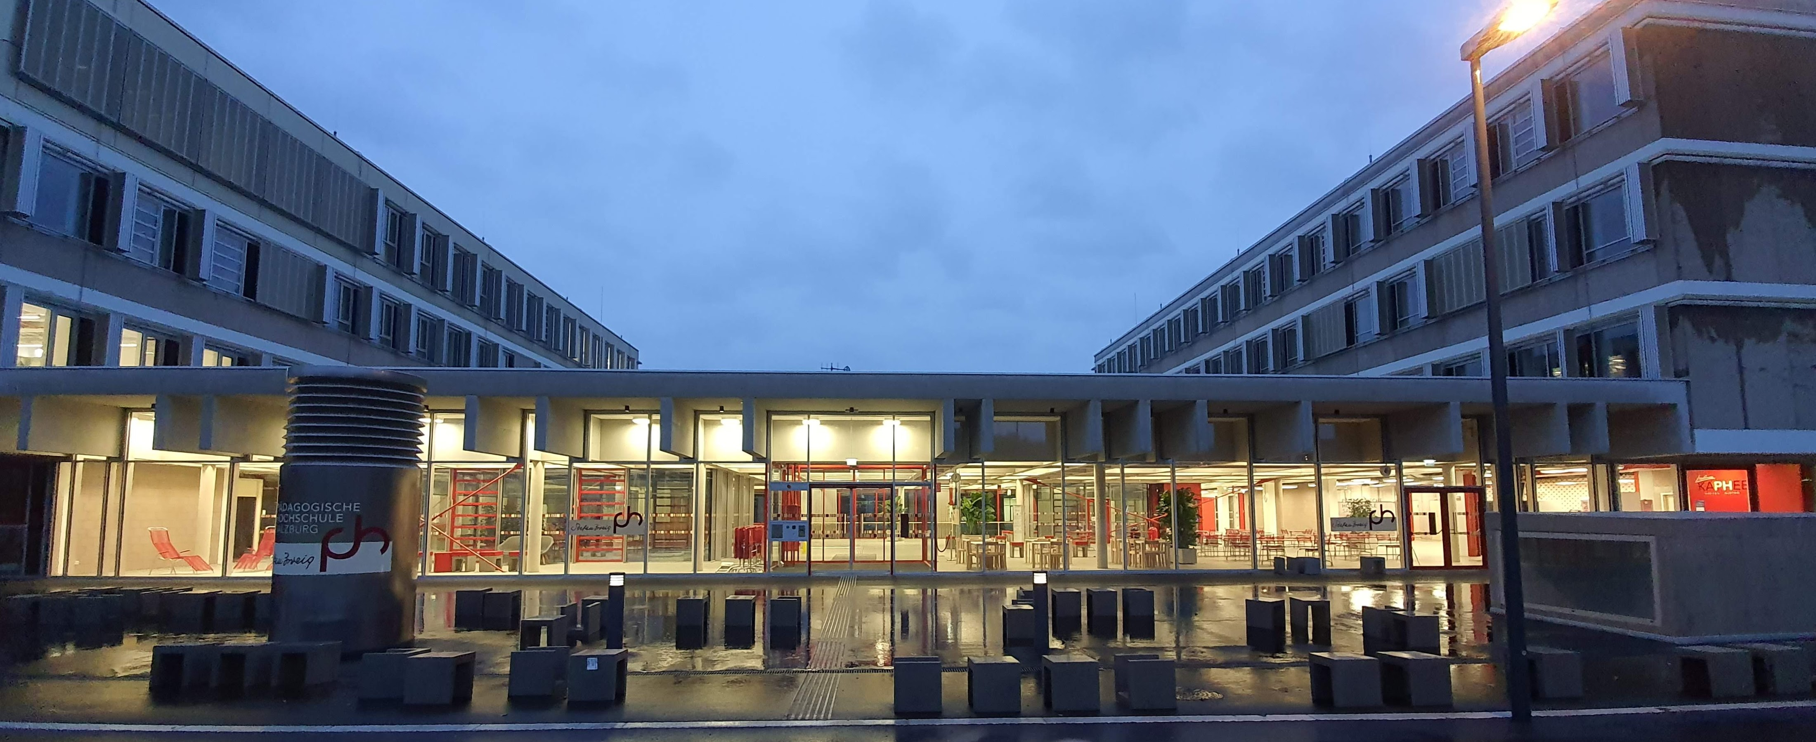
Venue
Institut für Professionsentwicklung & Schulqualität (IPS)

Slide 46
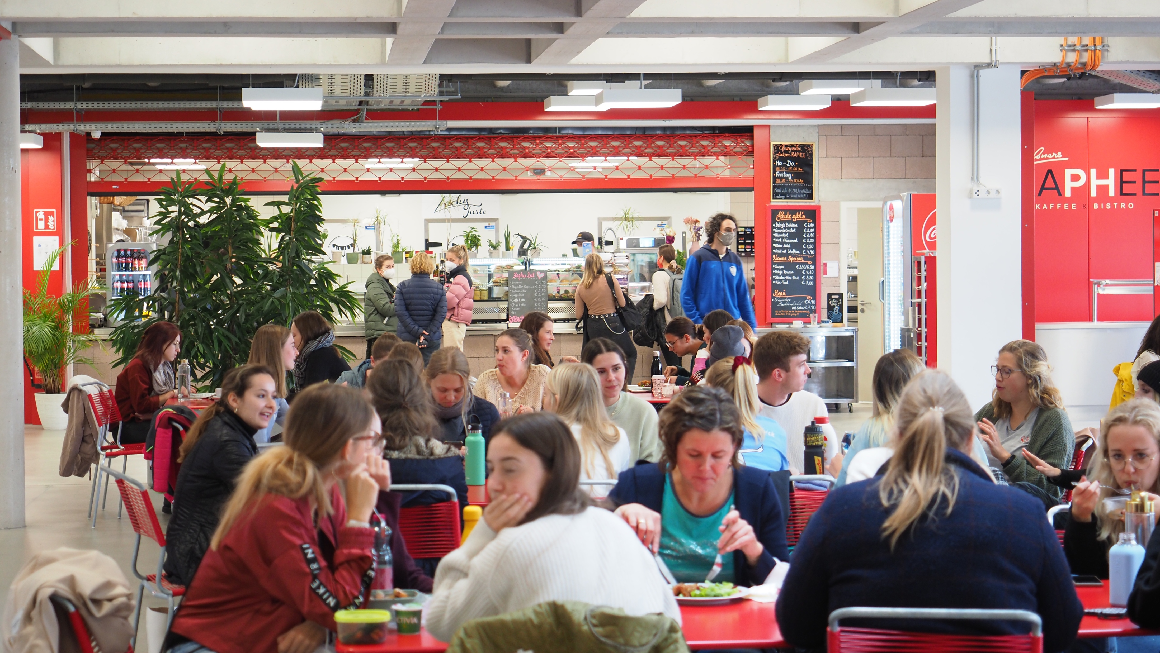
Venue

Slide 47
The City of Salzburg
Salzburg
Institut für Professionsentwicklung & Schulqualität (IPS)

Slide 48
Transport to Salzburg (eco-friendly travel)
By bicycle, on foot
Take Eurovelo 7 from Norway to Malta or the St. James‘s Pilgrimage Way along the river Salzach!
By train
Salzburg is on the main European railway line Paris – Budapest.
Frequent connections to Vienna and Munich
Institut für Professionsentwicklung & Schulqualität (IPS)

Slide 49
Transport to Salzburg (not so eco-friendly)
By car
Take one of the main motorways:
A1 from Vienna, A10 from Italy, A8 from Germany
By plane (and train)
Salzburg Airport W.A. Mozart is 4km from the city centre.
Vienna airport is 3 hours, Munich Airport 2 hours from Salzburg.
Institut für Professionsentwicklung & Schulqualität (IPS)

Slide 50
Accommodation
Salzburg is a tourist city. Many visitors stay overnight.
booking.com search June 8, 2024 for 2025:
price range up to €150/night – 34 results
price range up to €200/night – 64 results
Please, book as early as possible!
Institut für Professionsentwicklung & Schulqualität (IPS)

Slide 51
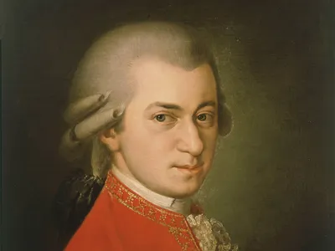
Auf Wiedersehen in Salzburg!
See you in Salzburg next year!
Institut für Professionsentwicklung & Schulqualität (IPS)

Slide 52
7. AOB

Slide 53

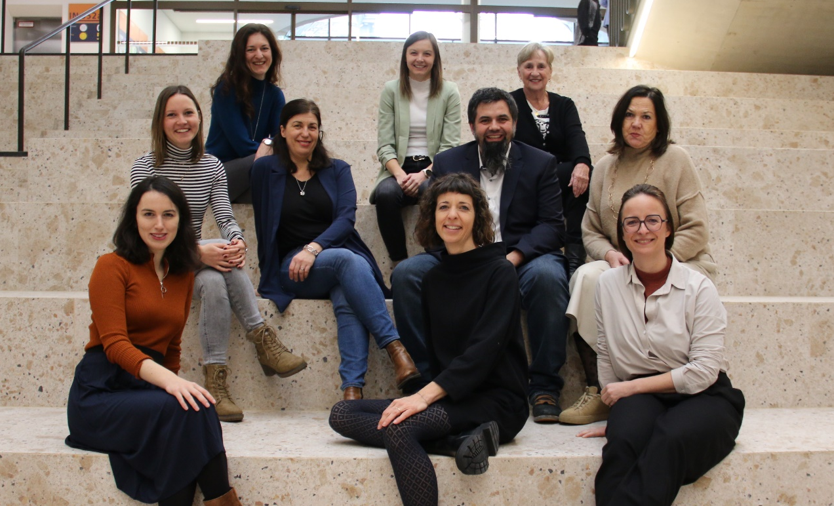
The Language Testing Research Group Innsbruck (LTRGI)
invites you to the…

Slide 54

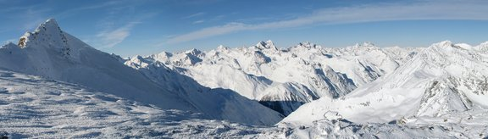
2nd EALTA Winter School
December 9-13, 2024
Innsbruck, Austria

Slide 55
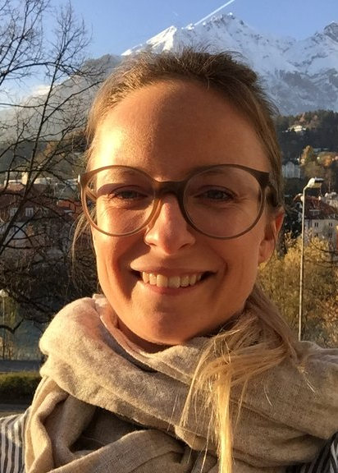
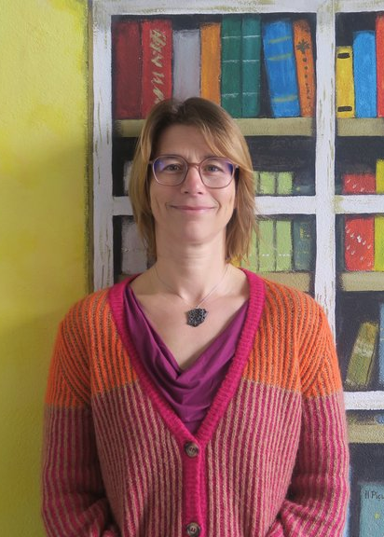
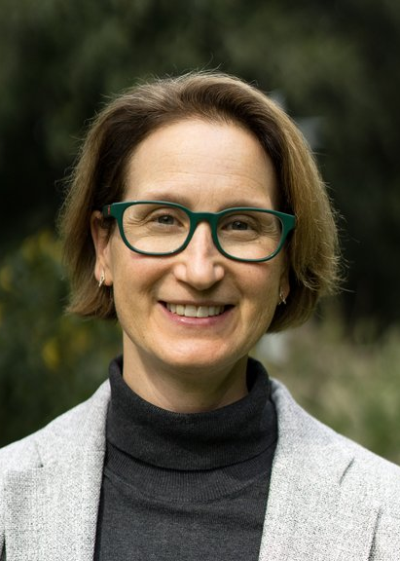
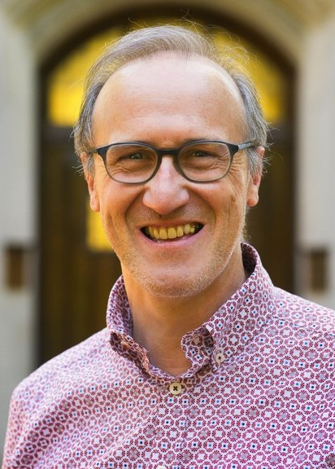
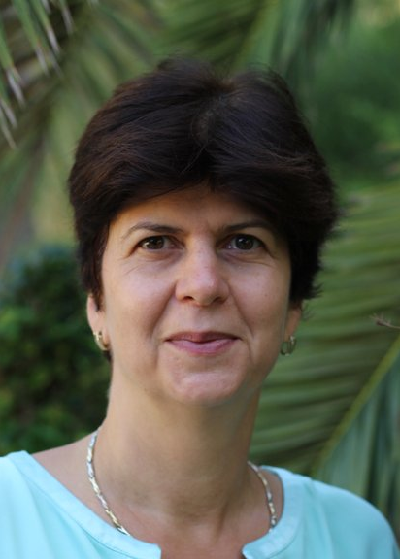
Tasks in language assessment
Kathrin Eberharter [University of Innsbruck]
Marije Michel
[University of Groningen]
Paula Winke
[Michigan State University]
Koen Van Gorp
[Michigan State University]
Judit Kormos
[Lancaster University]

Slide 56
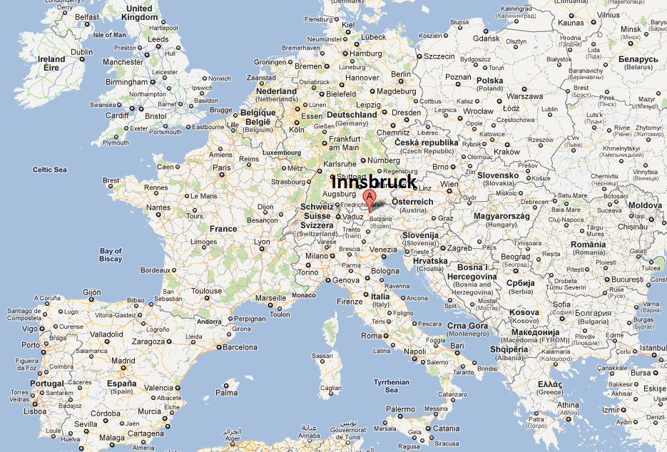
Welcome to Innsbruck!
Fly to…
Innsbruck
Munich (150 km)
Salzburg (190 km)
Zurich (290 km)
Vienna (500 km)

Slide 57
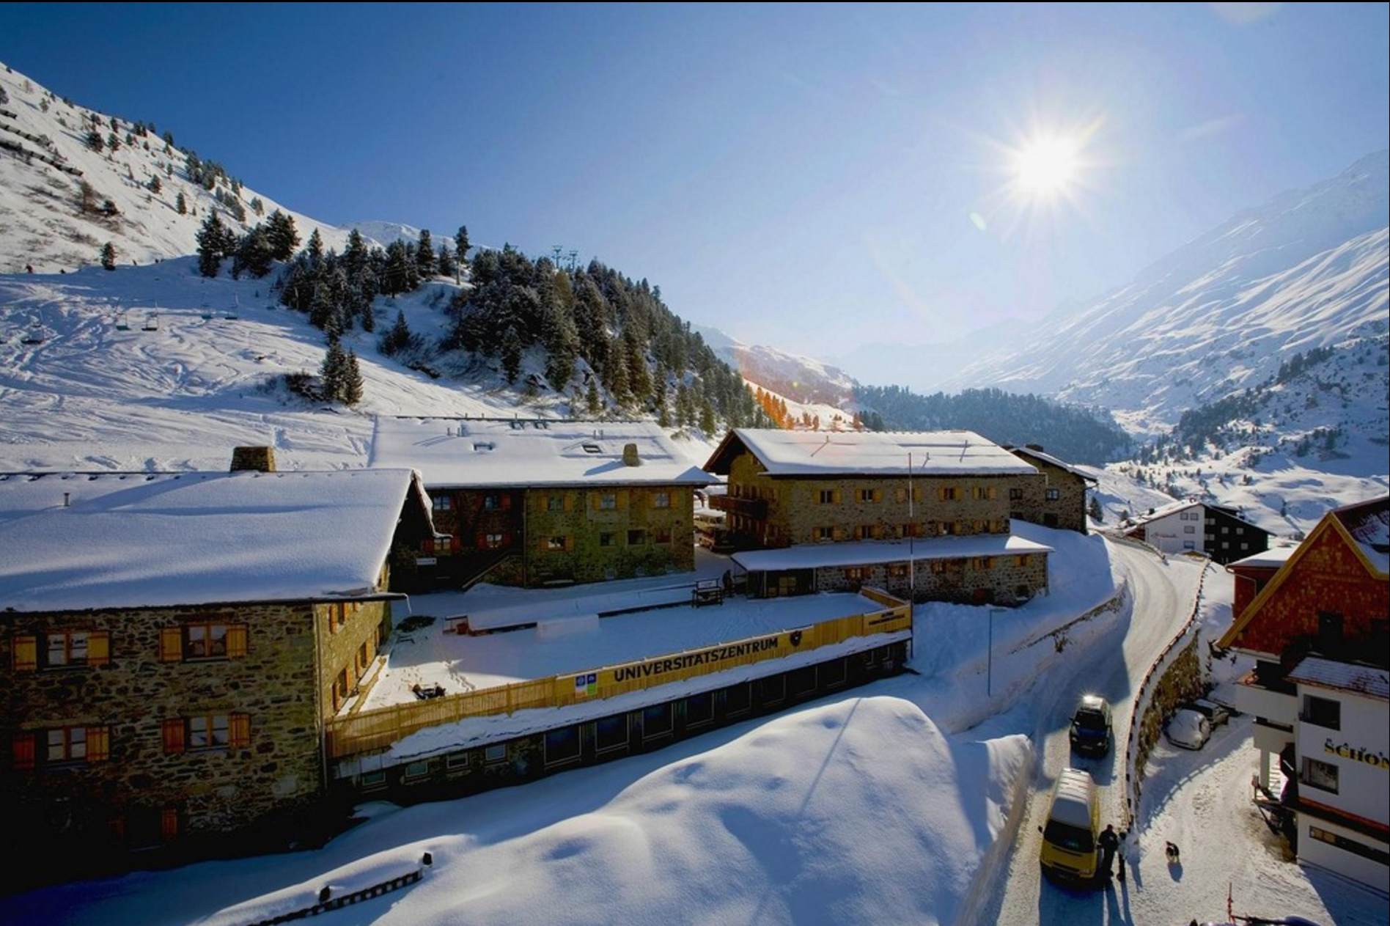
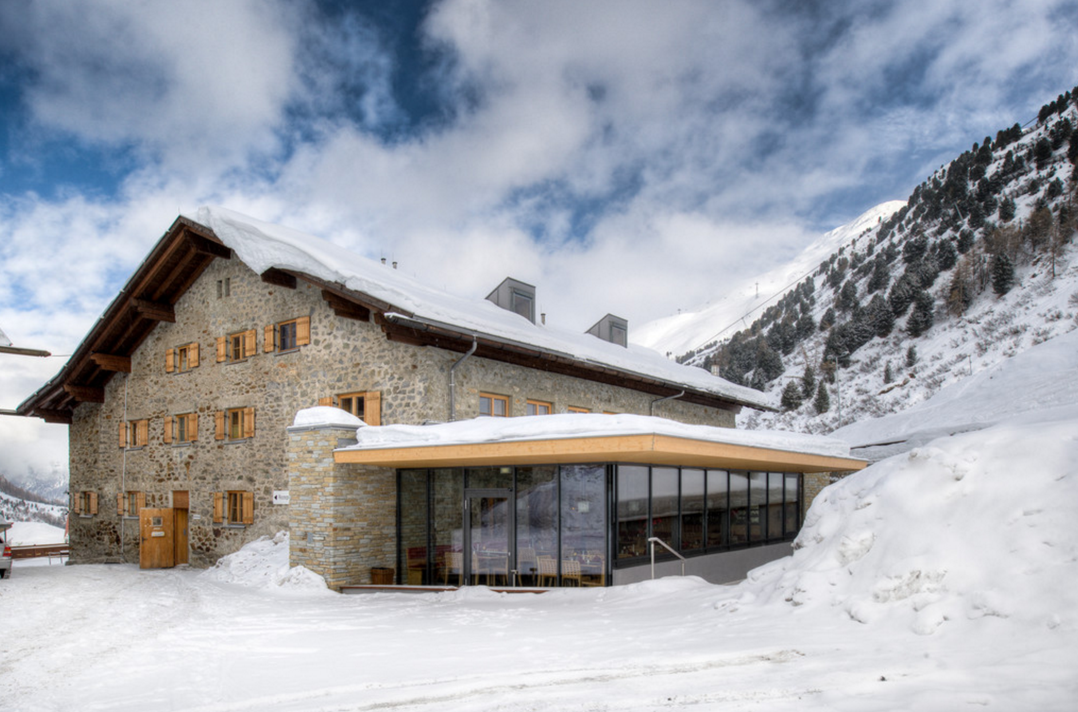
University Center Obergurgl
https://www.uz-obergurgl.at/

Slide 58
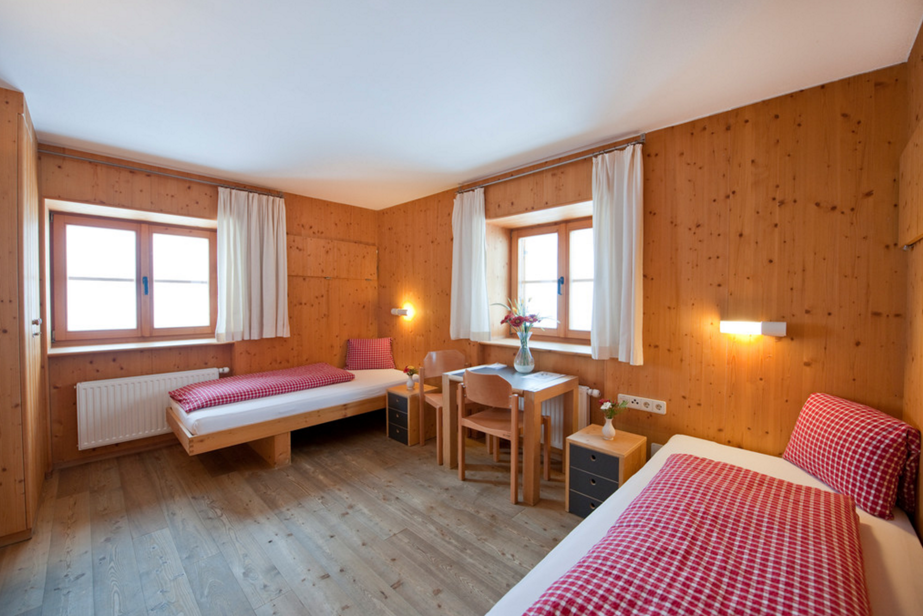
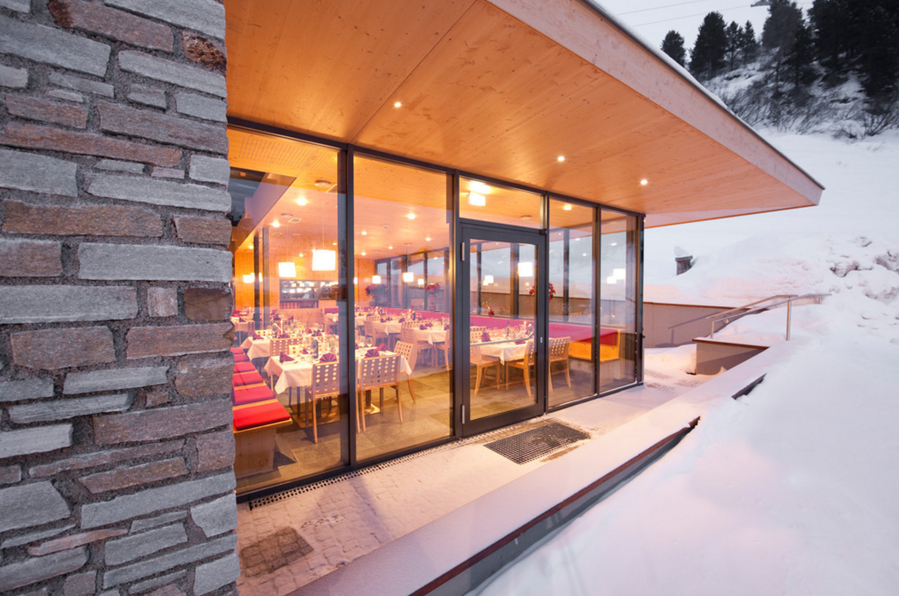
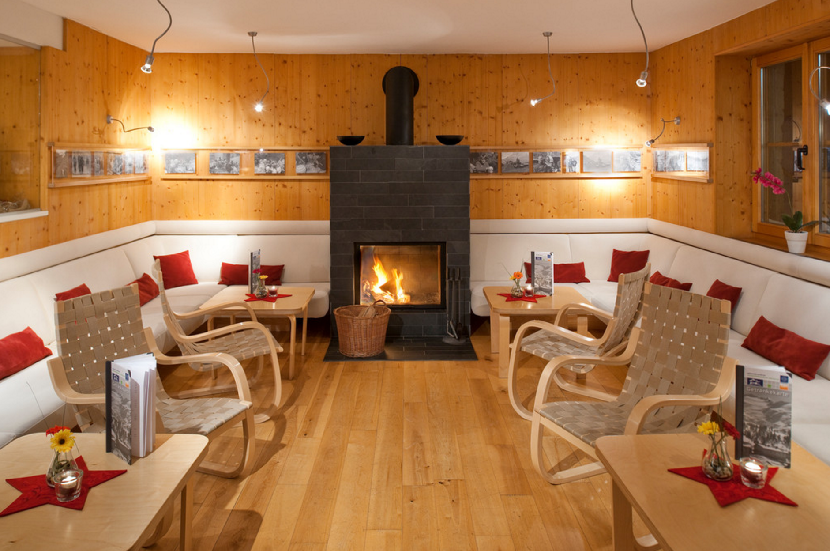
University Center Obergurgl

Slide 59
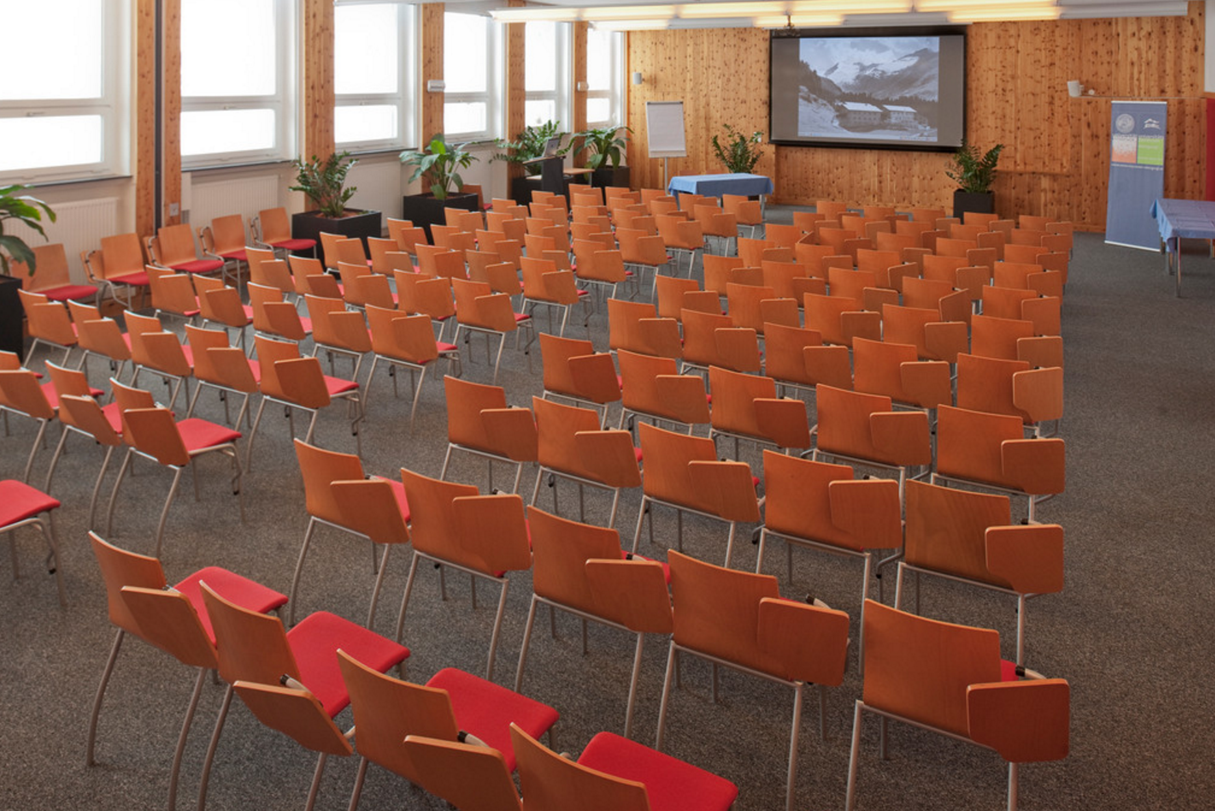
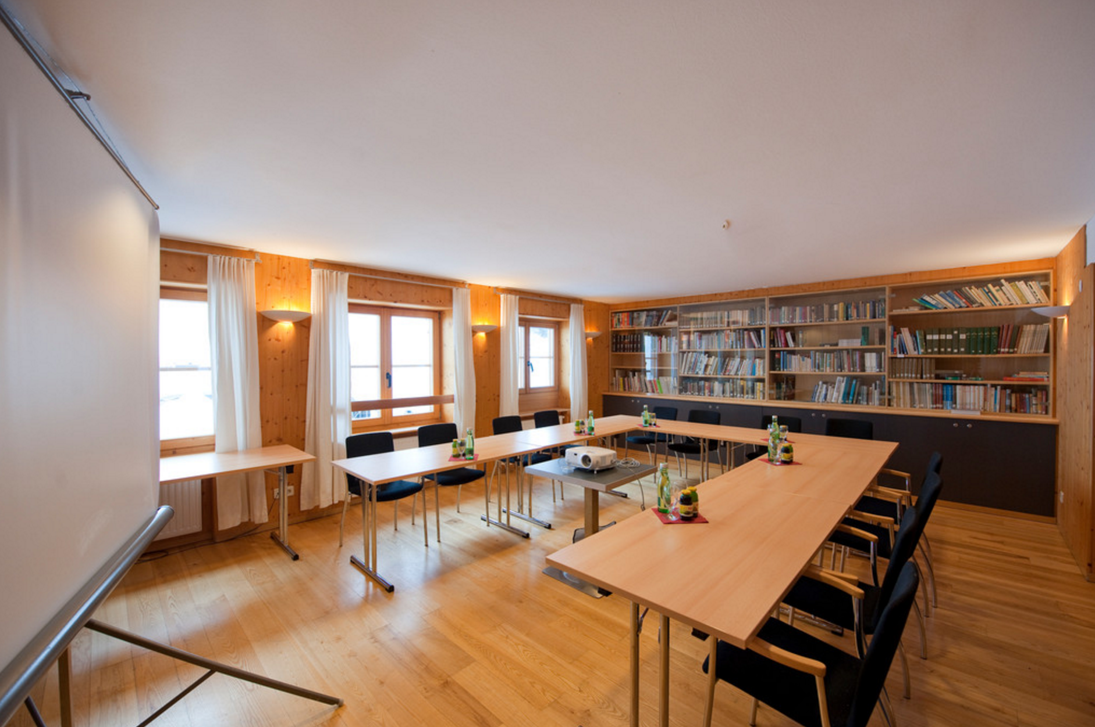
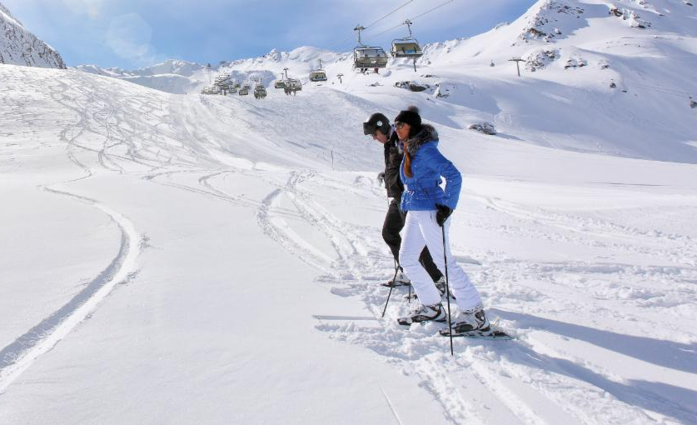
University Center Obergurgl

Slide 60
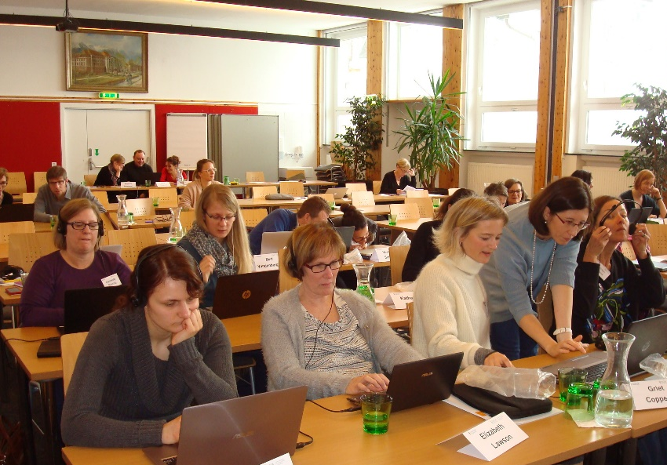
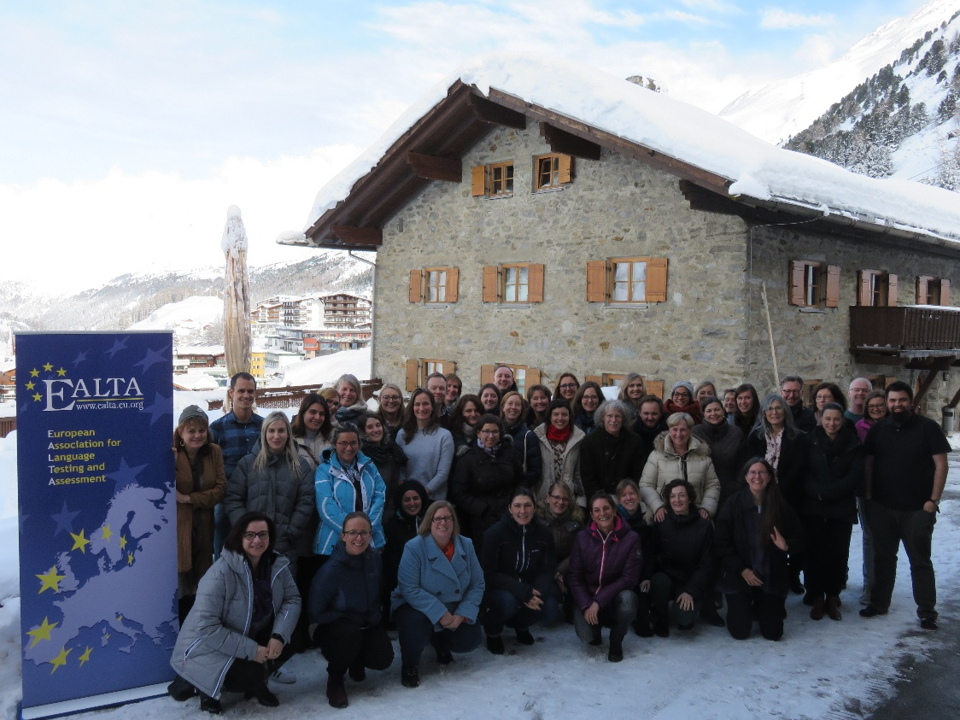
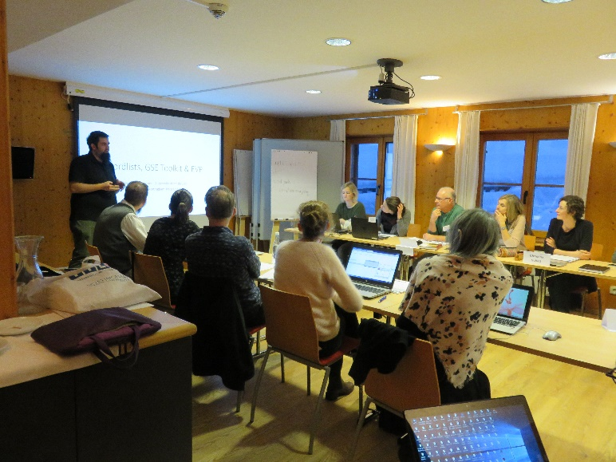
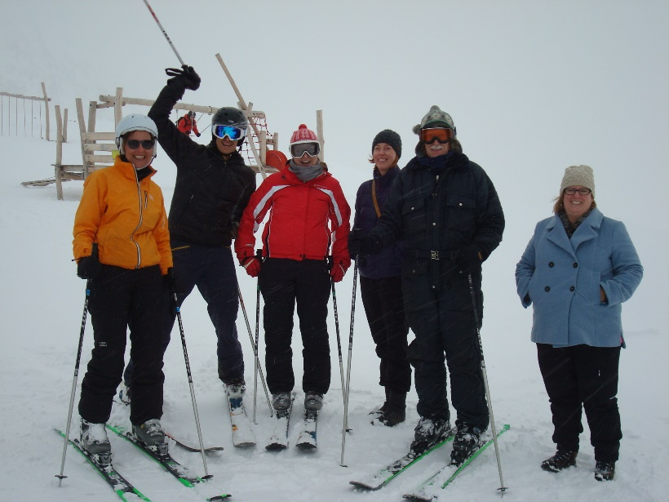
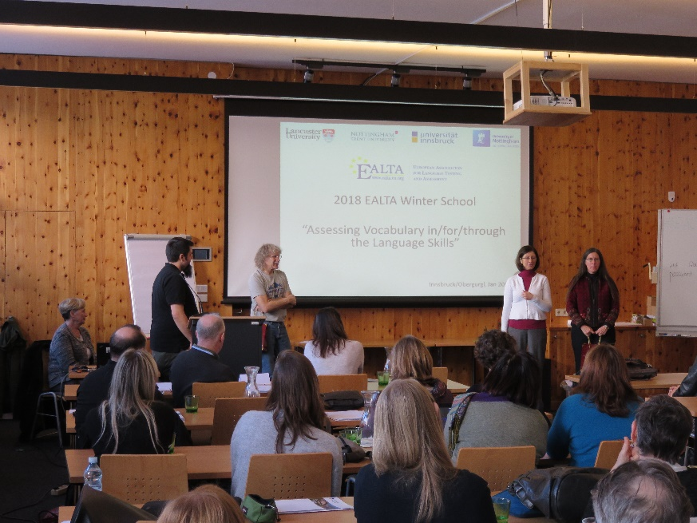
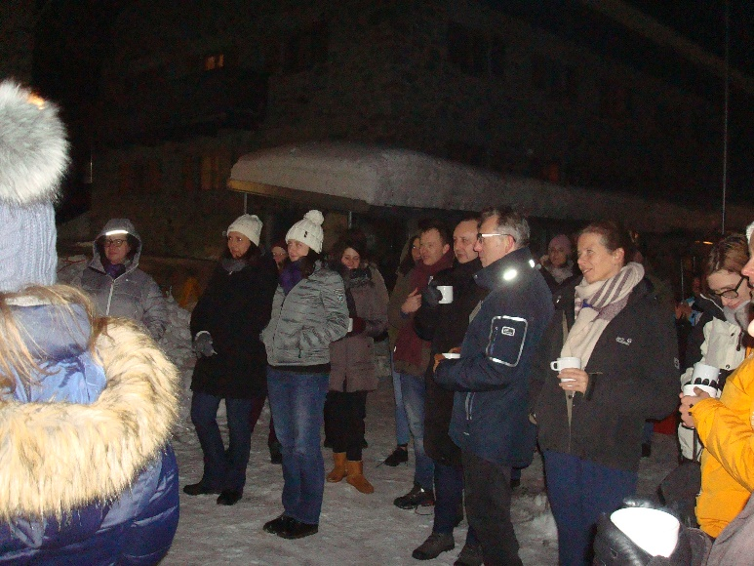
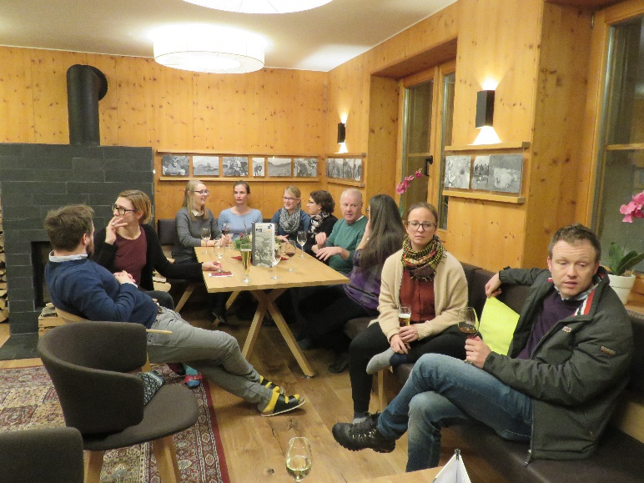
Impressions from the first EALTA Winter School 2018

Slide 61
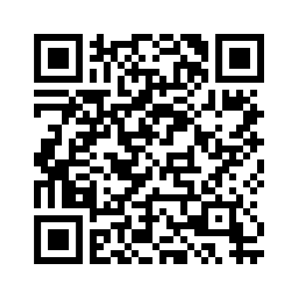
Join us…
2nd EALTA Winter School
Tasks in language assessment
December 9-13, 2024
Innsbruck, Austria
Places limited, Register now!

